Slide 1
Social Service Application – Me4U
Project By
Vanessa Almond
Sachin George
Advaith Kamath
Nisha Thomas

Slide 2
The Idea

Slide 3
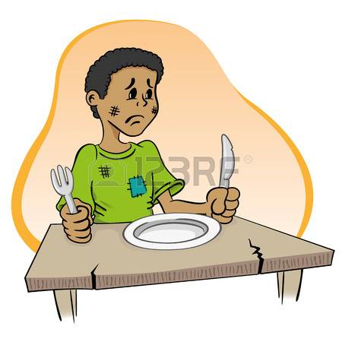
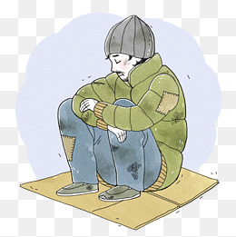
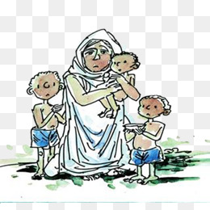
Concerns -
Rising Poverty
Need to fulfill basic needs of people
Right to live a good life

Slide 4
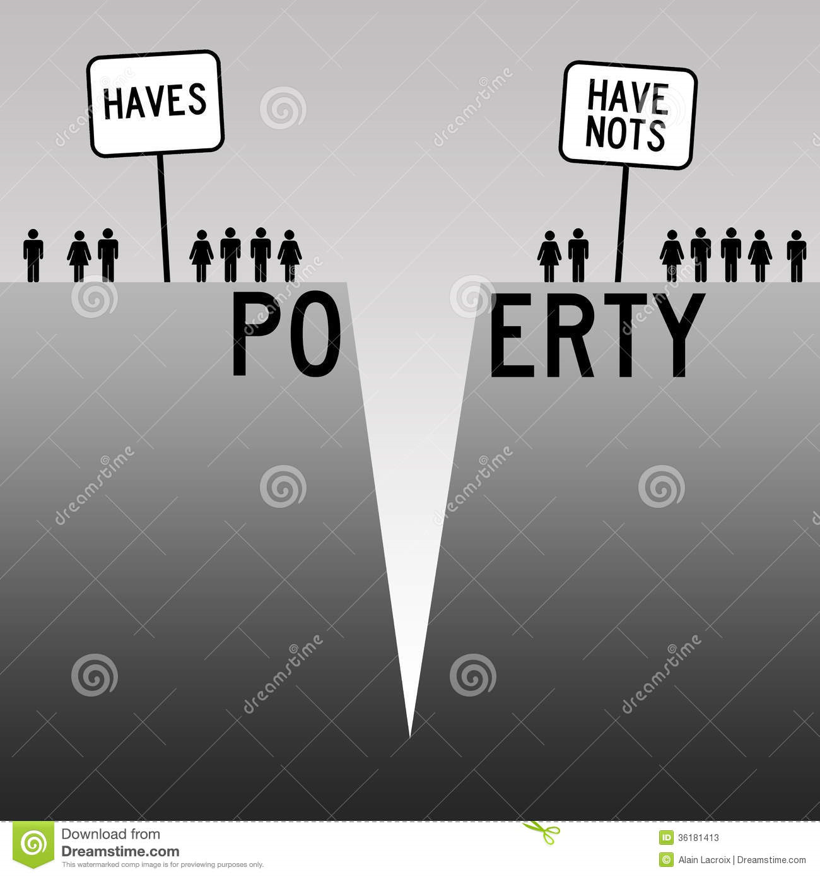
An imbalance among people having a lot of amenities and people who starve for a little of those.

Slide 5
Bridging This Gap
In such a scenario, we also see a lot of organizations and NGOs who work to bridge this gap.
They donate all that they receive to the needy.

Slide 6


Slide 7


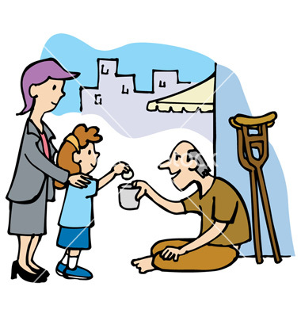

Slide 8

Issue
People with excess of clothes, food items and other amenities, and have the desire to donate them to the people in need, don’t know whom to contact and how to reach the needy.
Whom do I contact? I want to donate!

Slide 9


Slide 10
Introducing our system – Me4U
An application to connect people who wish to donate amenities, food and clothing with trusted organizations who donate them to the people in need.

Slide 11
Screenshots – User Side

Slide 12

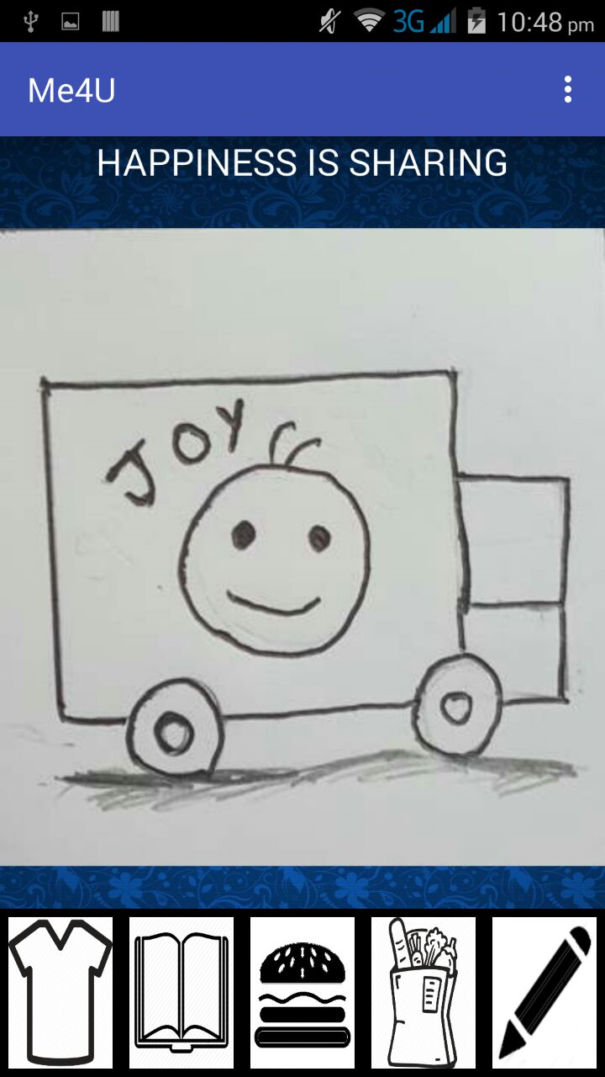

Slide 13
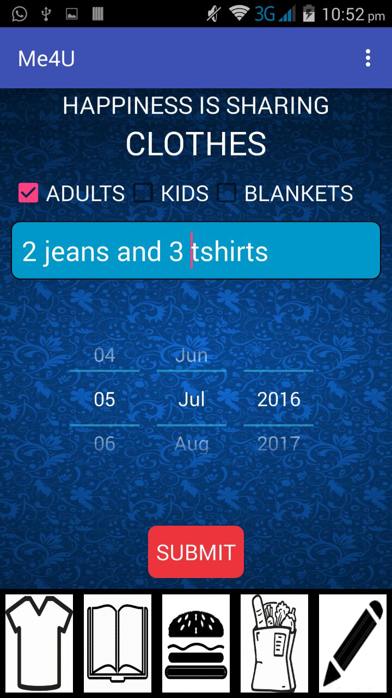
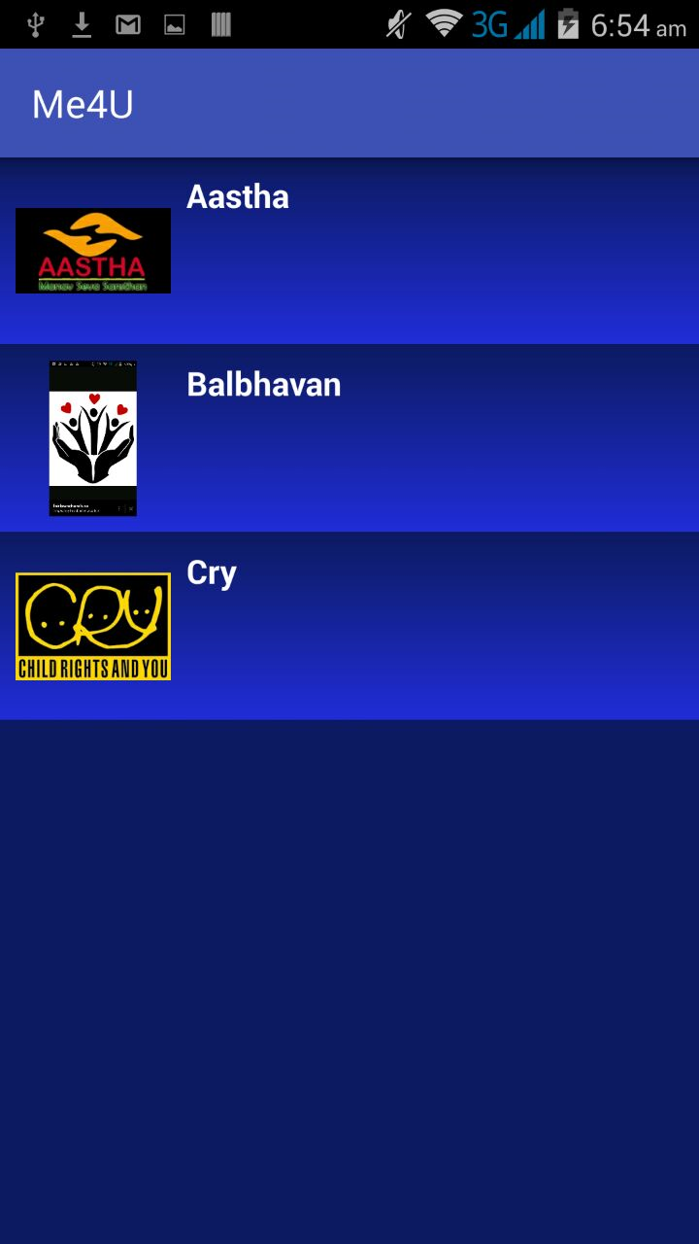

Slide 14
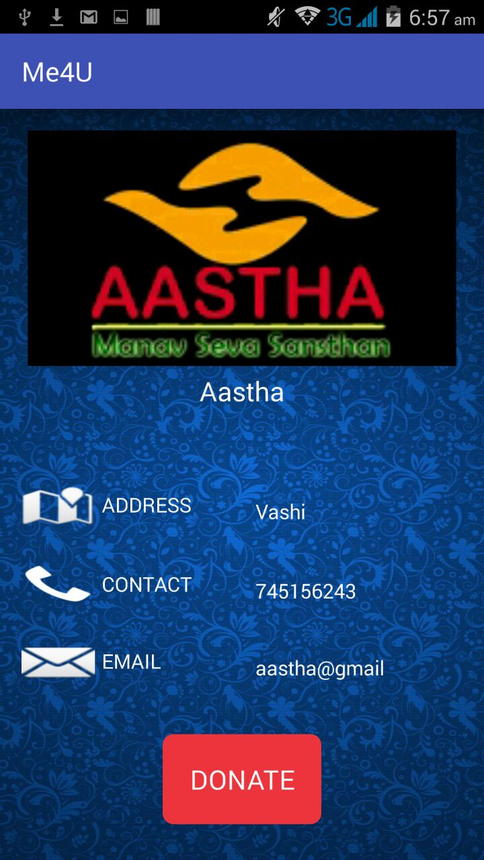
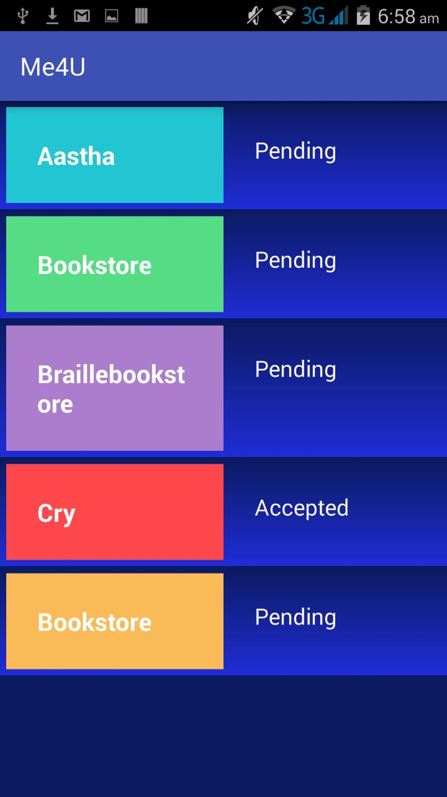

Slide 15
Screenshots – Organization Side

Slide 16
